Slide 1

COVID -19
Presented BY:-

Slide 2

Outline
Problem Statement
Objective
Microservices
Project Overview
Onboarding-Architecture
Project Flow
Technology and Tools used
Challenges
Conclusion

Slide 3

Problem Statement
Add here….

Slide 4

Objective
The Main objective of this project is to ….

Slide 5
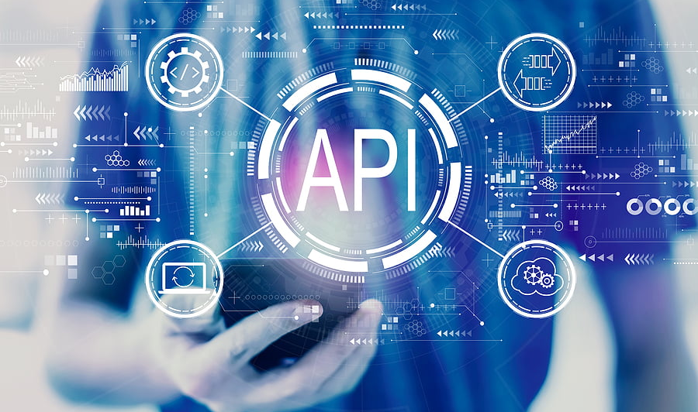
Microservices
1
2
3

Slide 6
Project Overview

Slide 7
Project Overview
Watchlist
Login
CovidCases
API
Vaccination
API
CovidTest
API
Watchlist
API
Home
Register
Search
SQL
Server
SQL
Server
SQL
Server
External API

Slide 8
Architecture
Authentication API
JWT validator
SQL Server
Login/Register
POST request
Token generated
Weather API
Get Weather
Delete Weather
Update Weather
POST /GET/
UPDATE/
DELETE
SQL
Server
GET/DELETE
Front End
Angular
GET
Rainfall API
Get Rainfall
SQL
Server
GET
Search by city/country
External API
GET
GET

Slide 9
Onboarding Architechture

Slide 10
Architecture

Slide 11

Project Flow

Slide 12

Front End
HTML
CSS
JAVA SCRIPT
TYPE SCRIPT
BOOTSTRAP ANGULAR

Slide 13
Back-End
ASP.NET CORE
MS SQL
MONGODB

Slide 14









Technologies and Tools used

Slide 15
Challenges Faced

Slide 16
Learnings

Slide 17
Future Plans

Slide 18
Conclusion

